Slide 1

Cane with Millimeter Wave Radar for Base of Support Measurement
Ibai Gorordo Fernandez, Chikamune Wada
Kyushu Institute of Technology (Japan)
2019 IEEE 1st Global Conference on Life Sciences and Technologies (LifeTech 2019), March 13 - 2019

Slide 2
Outline
Introduction
Proposed system
Validation experiment
Results
Conclusion

Slide 3
1. Introduction
Notes:
-First of all, I want to talk about why we want to use an electromagnetic tracker.

Slide 4
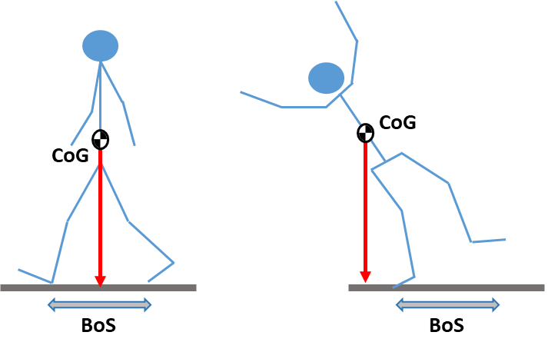
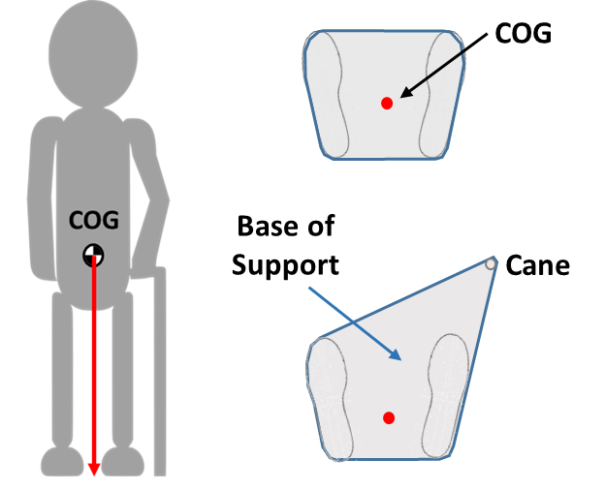
Falls
According to a report from the World Health Organization (WHO), 28-35% of people over the age of 65 fall every year.
Balance is defined as the condition in which the Center of Gravity (CoG) is maintained inside the Base of Support (BoS).
There is a need to develop systems that can help improve balance to reduce the risk of falls.
Notes:
As we all know, falls are a global health issue that affects especially to the elderly.
According to the World Health Organization, it is estimated that around 30% of the people over the age of 65 fall every year.
Falls happen when the Center of gravity (stop and point the center of gravity)
Exists the base of support as shown in the image in the left (stop and point the left image)
The Base of Support refers to the are between the feet as shown in the image in the right (stop and point to the right image)
Therefore, when the center of gravity (stop and point again to my CoG)
Exits the base of support (stop and point at the area of my feet)
We are no longer to keep balance and we fall.

Slide 5
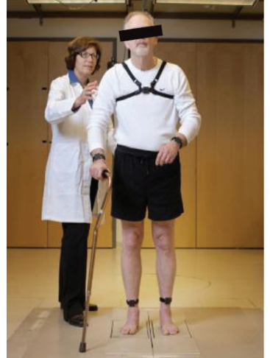
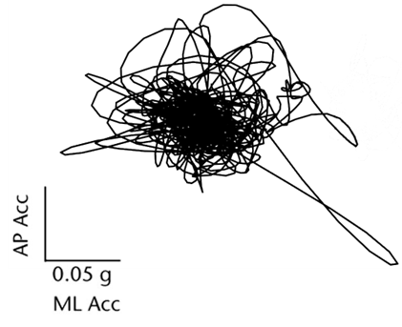
Previous solutions
Inertial sensors:
Low cost and small size.
Normally the inertial sensor is placed in the trunk near the CoG.
Features such as sway area, sway velocity and Root mean square (RMS) acceleration are normally extracted for balance analysis [1].
Limitation:
Information about the BoS is missing.
[2]
Notes:
[1]Wearable Sensor Use for Assessing Standing Balance and Walking Stability in People with Parkinson’s Disease: A Systematic Review
[2]Paper: Role of Body-Worn Movement Monitor Technology for Balance and Gait Rehabilitation

Slide 6
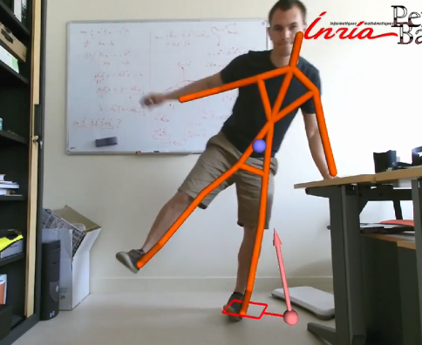
2. Optical systems
Previous solutions (2)
2.1. Motion capture systems [3]:
Use of multiple cameras to track the position of the markers in the body.
High accuracy.
Limitation:
Expensive.
Limited region of analysis.
2.2. Kinect camera [4]:
Display balance in real time.
Limitation:
Requires a model of the mass distribution (generated using a Wii balance board, Nintendo).
[4]
Notes:
[4] Center of mass and base of support interaction during gait
[5] Adaptive Interface for Personalized Center of Mass Self-Identification in Home Rehabilitation
RMSE CoM 3 cm

Slide 7
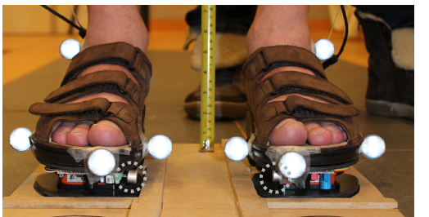
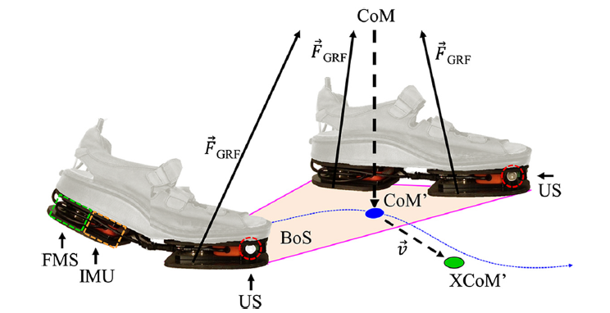
3. ForceShoe [5,6]
Previous solutions (3)
Combination of multiple sensors:
Inertial sensor.
3D Force/Moment sensors.
Ultrasonic sensor.
Absolute error:
Step length: 1.7 ± 2 cm
Step width: 1.5 ± 1.5 cm
Limitation:
Use of special shoe is required, with a weight of 1 Kg and a height of 2.5 cm due to the sensors.
[6]
Notes:
[6] Ambulatory Estimation of Relative Foot Positions byFusing Ultrasound and Inertial Sensor Data
[7] Ambulatory assessment of walking balance after stroke using instrumented shoes

Slide 8
Objective
In this research we present our initial work on the development of a sensor to analyze balance for cane users in everyday life.
Measurement of the Base of Support using a sensor attached to the cane.
Estimation of the accuracy of the system to measure the Base of Support.
Calculate and display the Base of Support in real time for rehabilitation applications.

Slide 9
2. Proposed system
Notes:
-First of all, I want to talk about why we want to use an electromagnetic tracker.

Slide 10
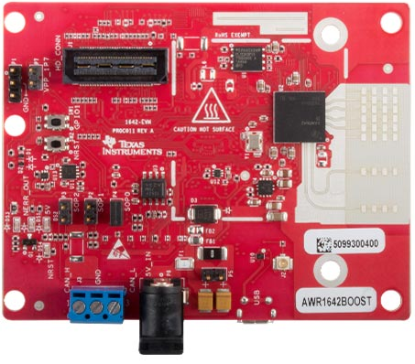
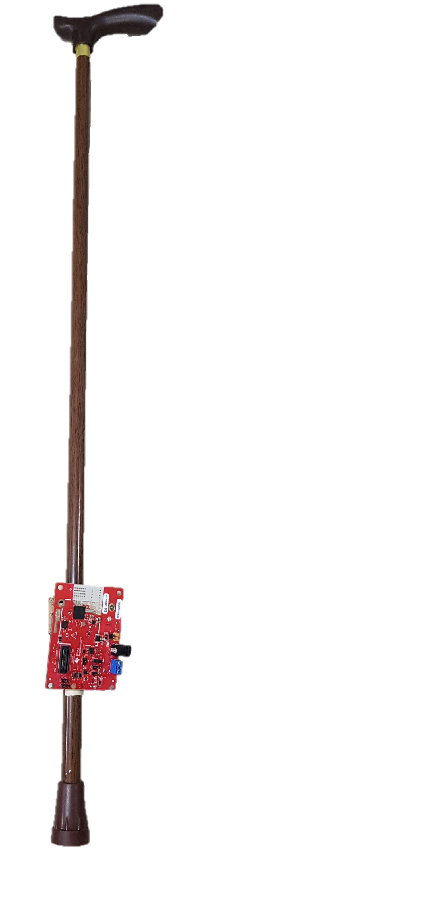
Instrumented Cane
Mm wave radar sensor
High accuracy and higher resolution (4cm) than other technologies (e.g. ultrasonic sensor).
AWR1642 (Texas Instruments)
Size: 6.5 x 8.2 cm.
Weight: 38 g.
Output: 2D position and Doppler velocity of reflected points.
Data rate: 20 Hz.
Field of view: 110 deg.
Connected to the computer by USB cable.
AWR1642BOOST

Slide 11
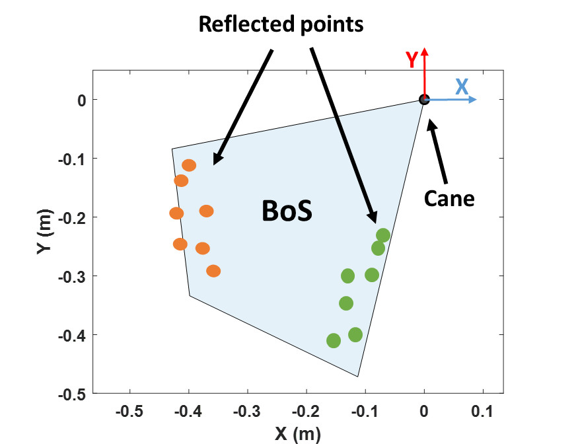
Base of Support Calculation
Radar
Using the point cloud of reflected points, it calculates the Base of Support by measuring the position of the feet.
2D position of reflected points
Preprocessing
Position transformation
DBSCAN clustering
Cluster identification
BoS calculation

Slide 12
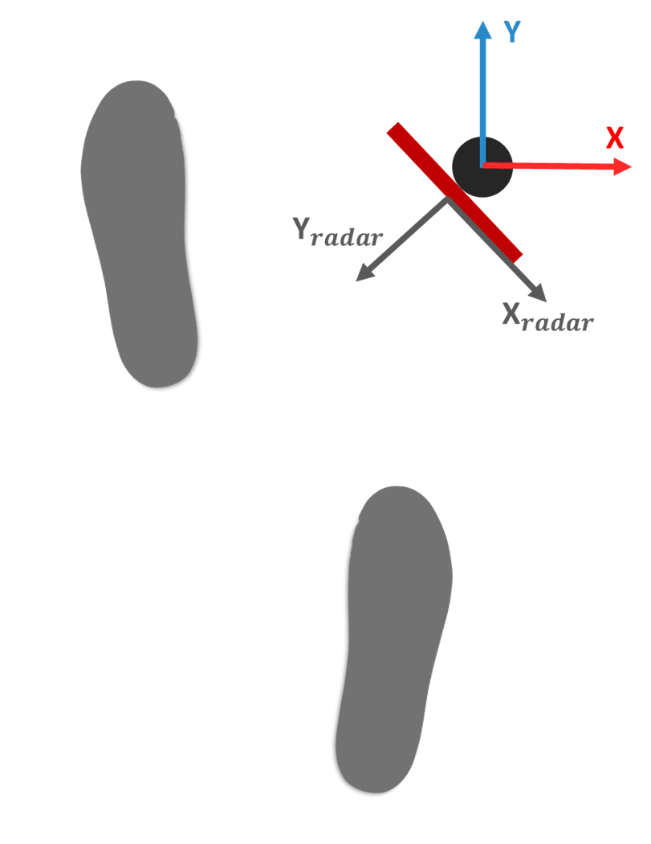
Preprocessing
Transform the 2D position of the reflected points from the local axis of the radar to the global axis of the cane.
Filter points outside the region of interest:
Points outside the range between 0.2 and 1.2 m were removed.

Slide 13
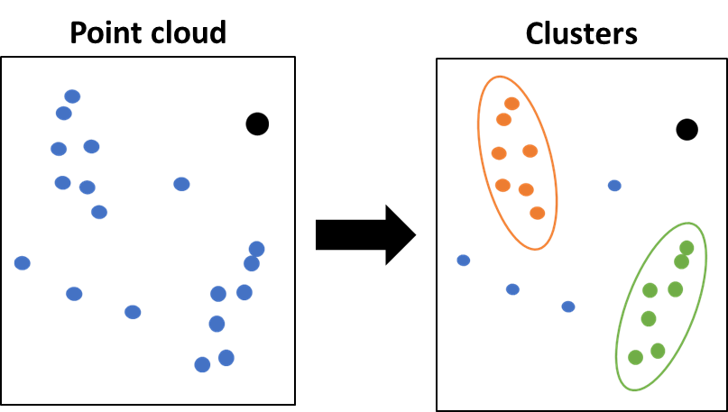
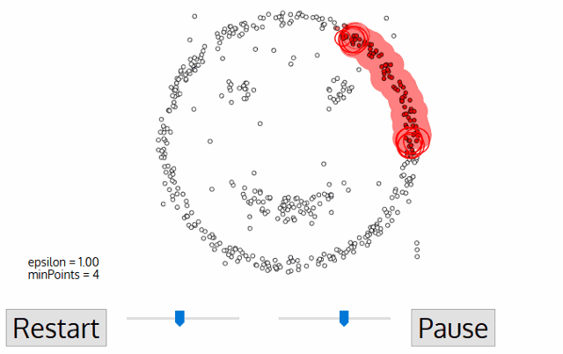
Clustering
It is necessary to cluster the reflected points to find the position of the feet.
Density-based spatial clustering of applications with noise (DBSCAN) was used.
Search for regions with high density of points.
Expand the clusters until the minimum density condition is not satisfied.
Two parameters: Epsilon (search radius) and minimum number of points.

Slide 14
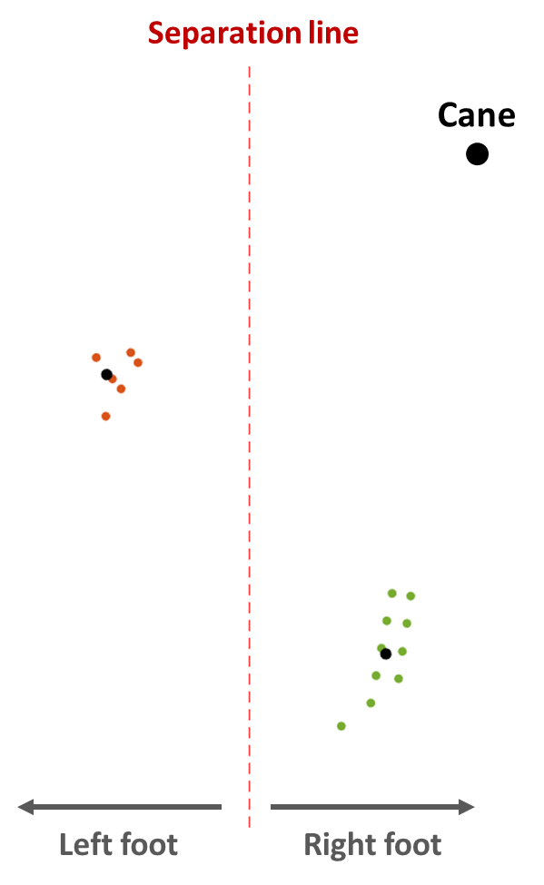
Tracking
Identify which cluster belongs to each foot.
Based on the knowledge that for right hand cane users, the right foot is closer to the cane.
Therefore, beforehand the system needs to know in which side the cane is used.
A separation line was used to divide the clusters.
Updated continuously with the current position of the centroids.
Notes:
In some cases, due to the few number of samples, only one cluster was detected, for that purpose we used a line to divide the clusters that updates with the current positions (show animation )

Slide 15
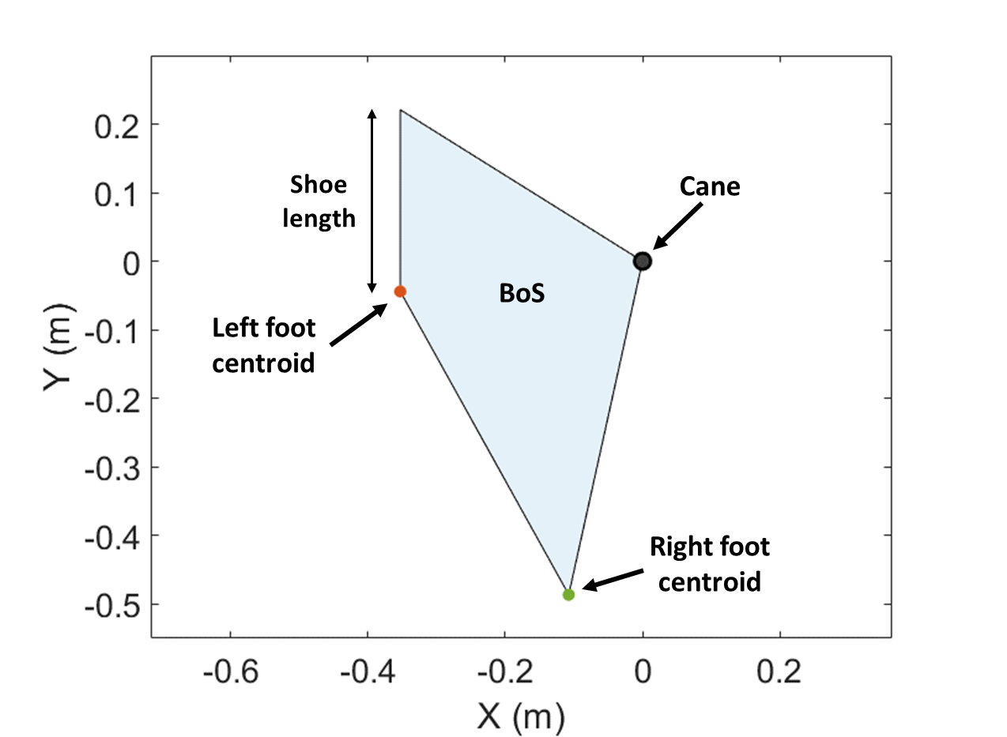
Base of Support calculation
The Base of Support was calculated using:
Position of the cane (origin).
Left foot centroid.
Right foot centroid.
Shoe length.

Slide 16
3. Validation Experiment
Notes:
-First of all, I want to talk about why we want to use an electromagnetic tracker.

Slide 17
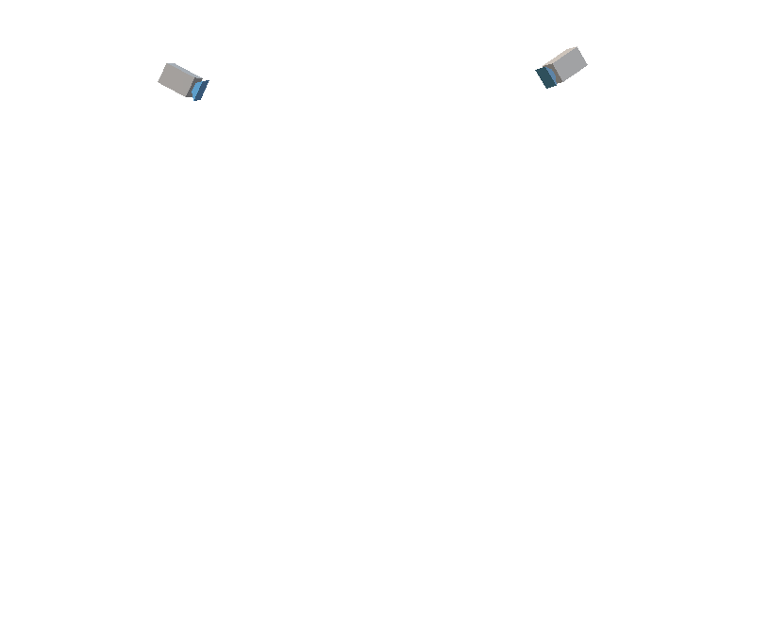
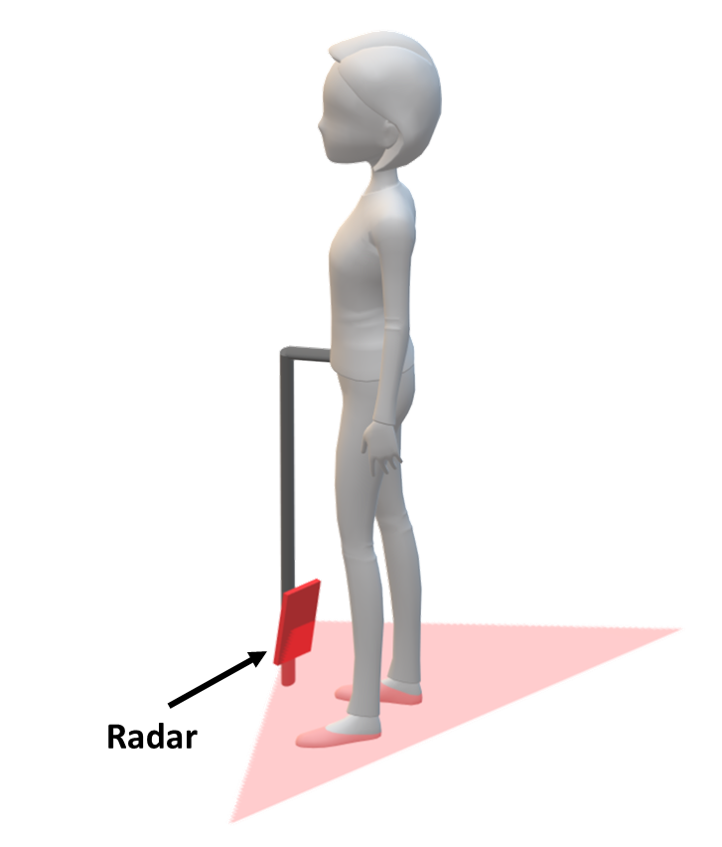
Experiment
Subjects were asked to stand for 2 second while using the instrumented cane at different step lengths and step widths.
Three young health males (age 24.67 ± 2.08).
Optical motion capture system (Flex 13, Optitrack) was used for validation.

Slide 18
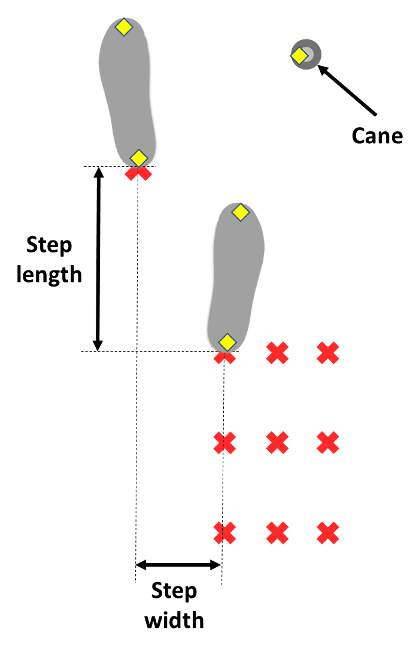
Experiment (2)
5 markers (yellow) were used to track the position of the feet and the cane.
The left foot was fixed while the right foot varied.
Total of 9 different patterns were measured based on the results in [7]:
3 step lengths (cm): 18.8, 28.6 and 38.4.
3 step widths (cm): 15.7, 19.6 and 23.5.
Each position was measured twice.
Notes:
Say that the position of the cane was selected by the user so that they felt confortable

Slide 19
4. Results
Notes:
-First of all, I want to talk about why we want to use an electromagnetic tracker.

Slide 20

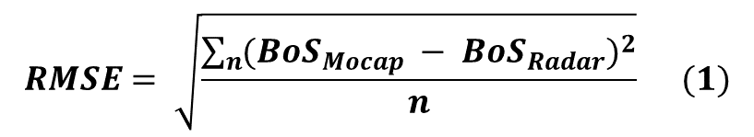

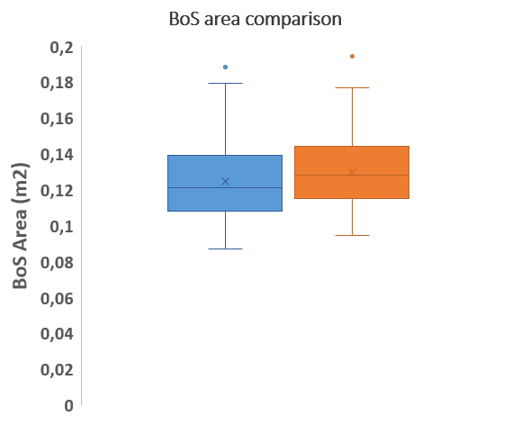
Results
For every measurement, the average BoS area was calculated.
The Root Mean Squared Error (RMSE) was calculated for the BoS area difference:
RMSE: 92.04 cm² (7.38 %).
$$RMSE= \sqrt{\frac{\sum_{n}{{({BoS}_{Mocap} − {BoS}_{Radar})}^{2}}}{n}} (1)$$
$$Relative error= \frac{RMSE}{{BoS}_{Mocap}} (2)$$

Slide 21
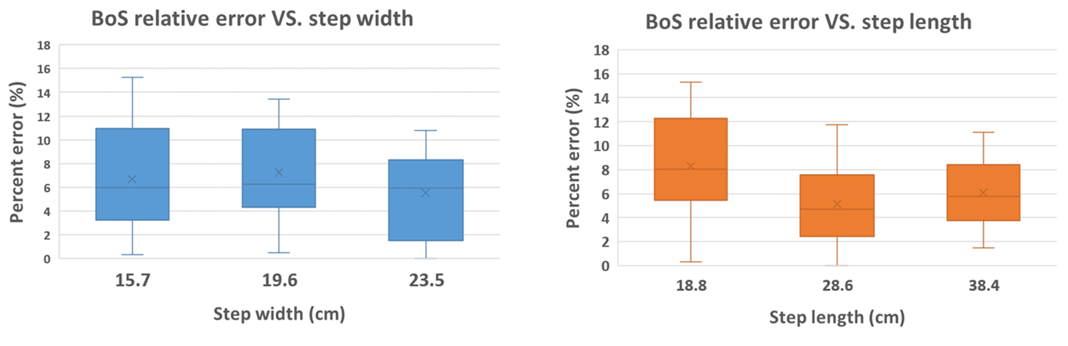
Results (2)
We compared the BoS relative error (%) at different step lengths and step widths.
Similar error at different foot positions, with a slightly bigger error for the 18.8 cm step length.

Slide 22
5. Conclusion
Notes:
-First of all, I want to talk about why we want to use an electromagnetic tracker.

Slide 23
Conclusions
Our proposed system was able to calculate the Base of Support with an error of 92.04 cm² (7.38 %).
We obtained similar accuracy for different step length and step width values.
We developed a graphical interface to show the user the current Base of Support in real time for rehabilitation applications.

Slide 24
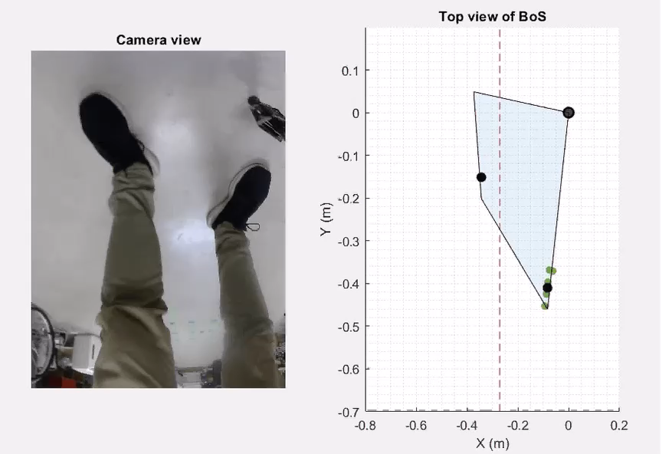
Real time demonstration

Slide 25
Limitations
The current prototype is connected to the computer via cable which limits the range of motion of the user.
The system can only be used while standing because both the tilt angle of the cane and the walked distance are unknown.
We still do not measure the position of the Center of Gravity which also has important information.

Slide 26
Future work
Transmit the data from the radar to the computer wirelessly.
Add a inertial sensor to the cane to calculate the tilt angle of the cane and the walked distance as in [8].
Measure the position of the Center of Gravity (CoG):
Place an inertial sensor in the trunk of the user to estimate the posture and the displacement of the CoG.
Ideally, we would use the same radar sensor to measure both the BoS and the CoG.

Slide 27
References
[1] R. P. Hubble, G. A. Naughton, P. A. Silburn, and M. H. Cole, “Wearable sensor use for assessing standing balance and walking stability in people with Parkinson’s disease: A systematic review” PLoS One, 2015.
[2] F. Horak, L. King, and M. Mancini, “Role of Body-Worn Movement Monitor Technology for Balance and Gait Rehabilitation” Phys. Ther., 2014.
[3] V. Lugade, V. Lin, and L. S. Chou, “Center of mass and base of support interaction during gait” Gait Posture, 2011.
[4] A. González, P. Fraisse, and M. Hayashibe, “Adaptive Interface for Personalized Center of Mass Self-Identification in Home Rehabilitation” IEEE Sens. J., 2015.
[5] D. Weenk, D. Roetenberg, B. J. J. F. Van Beijnum, H. J. Hermens, and P. H. Veltink, “Ambulatory estimation of relative foot positions by fusing ultrasound and inertial sensor data” IEEE Trans. Neural Syst. Rehabil. Eng., 2015.
[6] F. B. Van Meulen, D. Weenk, J. H. Buurke, B. J. F. Van Beijnum, and P. H. Veltink, “Ambulatory assessment of walking balance after stroke using instrumented shoes” J. Neuroeng. Rehabil., 2016.
[7] T. S. Kuan, J. Y. Tsou, and F. C. Su, “Hemiplegic gait of stroke patients: The effect of using a cane” Arch. Phys. Med. Rehabil., 1999.
[8] D. C. Dang and Y. S. Suh, “Walking Distance Estimation Using Walking Canes with Inertial Sensors”. Sensors, vol. 18(1), pp. 1-20, January 2018.

Slide 28
THANK YOU

